Slide 1
Client Side Scripting
Loops

Slide 2
Loops
Code loops are an important part of every programming language
Many programs need to repeat a sequence a given number of times or repeat a sequence until some value has changed or an action has occurred
JavaScript gives us the while, do, and for keywords to perform looping operations

Slide 3
Loops
Loops check a condition and if returns true, a code block will run
The condition will be checked again, and if it still returns true, the code block will run again
It repeats until the condition returns false

Slide 4
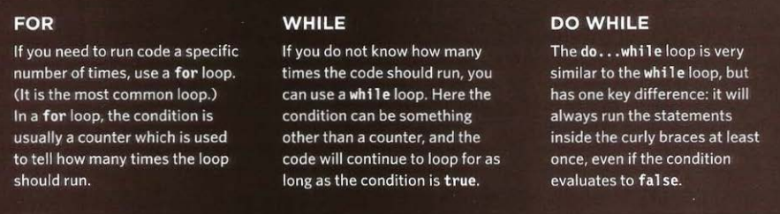
Loops
The different types of Loops in JavaScript:

Slide 5
Loops for loop
The for statement enables you to repeat a block of code a certain number of times
Therefore, you typically opt for a for loop when you know how many times the loop will need to execute
It is also chosen when you need a loop counter variable

Slide 6
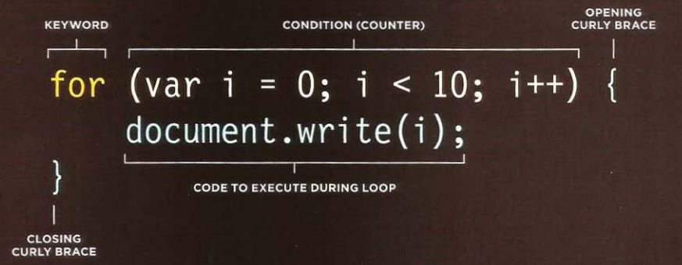
Loops for loop

Slide 7
Loops for loop
Just like the if and switch statements, the for statement also has its logic inside parentheses.
However, this time that logic is split into three parts, each part separated by a semicolon.

Slide 8
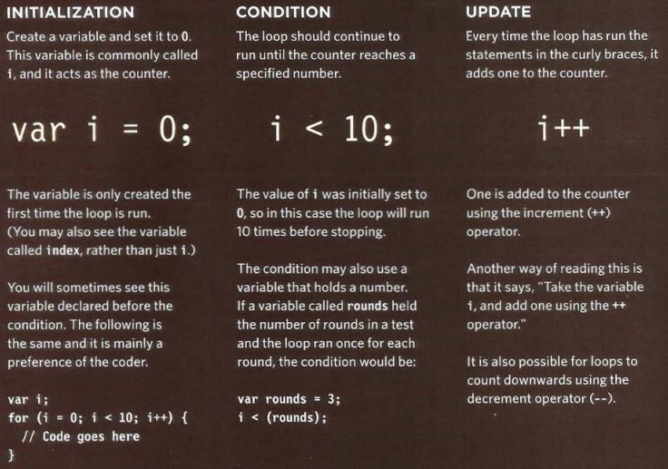

Slide 9
Loops for loop
Just like the if and switch statements, the for statement also has its logic inside parentheses
However, this time that logic is split into three parts, each part separated by a semicolon
The first part is the initialization part of the for statement
To keep track of how many times you have looped through the code, you need a variable
This variable is initialized at this stage
This part is only executed once during the execution of the loops, unlike the other parts

Slide 10
Loops for loop
The second part of the for loop is the test condition
The code inside the for statement will keep executing for as long as this test condition evaluates to true
After the code is looped through each time, this condition is tested
The number of times a loop is performed is often called the number of iterations
Finally, you have the increment part
At this stage the counter variable is incremented (value increased by 1)
Again, this part of the for statement is repeated with every loop of the code
Although we call it the increment part, it can actually be used to decrease, or decrement, the value

Slide 11
Loops for loop
After the for statement, comes the block of code that will be executed repeatedly, as long as the test condition is true. This block of code is contained within curly braces
If the condition is never true, even at the first test of the loop condition, the code inside the for loop will be skipped over and never executed
Putting all this together, how does the for loop work?
1. Execute initialization part of the for statement.
2. Check the test condition. If true, continue; if not, exit the for statement.
3. Execute code in the block after the for statement.
4. Execute the increment part of the for statement.
5. Repeat steps 2 through 4 until the test condition is false.

Slide 12
Loops while loop
Whereas the for loop is used for looping a certain number of times, the while loop enables you to test a condition and keep on looping while it’s true
The for loop is useful when you know how many times you need to loop; for example, when you are looping through an array that you know has a certain number of elements
The while loop is more useful when you don’t know how many times you’ll need to loop. For example, if you are looping through an array of temperature values and want to continue looping when the temperature value contained in the array element is less than 100, you will need to use the while statement

Slide 13
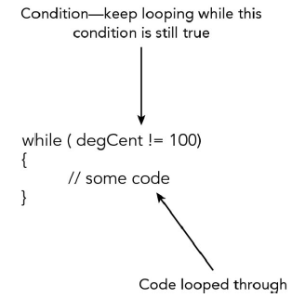
It is vital that in your code you ensure that the variable, used in your while condition, will be altered at a point in time.
One possible changes for this variable should result in a false ouptut for the while condition.

Slide 14
Loops do .. while loop
Considering the for loop and the while loop, if their conditions result to false even before the first iteration, the code enclosed in the loops will never be executed
However, there may be times when you want the code in the loop to execute at least once, regardless of whether the condition evaluates to true
It might even be the case that the code within the loop needs to be actually executed before running the condition

Slide 15
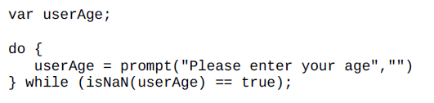
Loops do .. while loop
The do… while loop would be ideal to solve the previous mentioned issues
Consider an example where you want to get the user’s age via a prompt box. You want to show the prompt box but also make sure that what the user has entered is a number:

Slide 16
Loops do .. while loop
The do… while loop would be ideal to solve the previous mentioned issues
Consider an example where you want to get the user’s age via a prompt box. You want to show the prompt box but also make sure that what the user has entered is a number:

Slide 17
Loops do .. while loop
The code line within the loop:
userAge = prompt("Please enter your age","")
will be executed regardless of the while statement’s condition
This is because the condition is not checked until one loop has been executed
If the condition is true, the code is looped again
If it’s false, looping stops

Slide 18
Arrays and Loops
Loops are very helpful when dealing with arrays if you want to run the same code for each item in the array
For example, you might want to write the value of each item stored in an array into the page
You may not know how many items will be in an array when writing a script, but when the code runs, it can check the total number of items in a loop
That figure can then be used in the counter to control how many times a set of statements is run

Slide 19

Arrays and Loops
A for loop is very helpful for going through arrays. Example:
var myArray = ["Paul","Paula","Pauline"];
To access each element using a conventional for loop, you’d write this:

Slide 20
Arrays and Loops for ... in loop
Though, JavaScript provides a more straight forward loop specifically for lists
The for ... in loop, which enables you to iterate through each element in the array without having to know how many elements the array actually contains
In plain English, what this loop says is “For each element in the array, execute some code.”
Rather than having to work out the index number of each element, the for… in loop does it for you and automatically moves to the next index with each iteration

Slide 21

Arrays and Loops for ... in loop
Its syntax for use with arrays is:
In the above code, index is a declared temporary variable which will be automatically populated with the next index value in the array
arrayName is the name of the variable holding the array you want to loop through

Slide 22

Arrays and Loops for ... in loop
If we refer to the previous array example:
var myArray = ["Paul","Paula","Pauline"];
We used the for loop
With the for ... in loop, we can implemented it as so:

Slide 23
Loop keywords break
This keyword causes the termination of the loop and tells the interpreter to go onto the next statement of code outside of the loop
We say that the break statement "jumps out" of a loop
This is sometimes also used in functions

Slide 24
Loop keywords continue
The continue statement breaks one iteration (in the loop), if a specified condition occurs, and continues with the next iteration in the loop
We say that the continue statement "jumps over" one iteration in the loop

Slide 25
Loops Performance Issues
It is important to remember that when a browser comes across JavaScript, it will stop doing anything else until it has processed that script
If your loop is dealing with only a small number of items, this will not be an issue
If, however, your loop contains a lot of items, it can make the page slower to load

Slide 26
Loops Performance Issues
If the condition never returns false, you get what is commonly referred to as an infinite loop
The code will not stop running until your browser runs out of memory (breaking your script)
Any variable you can define outside of the loop and that does not change within the loop should be defined outside of it
If it were declared inside the loop, it would be recalculated every time the loop ran, needlessly using resources

Slide 27

Practice
Access Moodle and work out Worksheet 10

Slide 28
References
Johnson, G. (2013). Programming in HTML5 with Javascript and CSS3. United States of America: Microsoft Press.
McPeak, J. (2015). Beginning JavaScript, 5th Edition (5 ed.). Wrox.
Haverbeke, M. (2011). Eloquent JavaScript: A Modern Introduction to Programming. (S. Yang, Ed.) San Francisco: William Pollock.
McFarland, D. S. (2014). JavaScript & jQuery (3 ed.). United States of America: O’Reilly Media, Inc.
Duckett, J. (2014). JavaScript and JQuery Interactive Front-End Web Development (1 ed.). Wiley.

